Slide 1

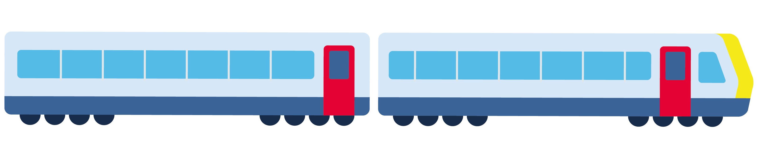

I dare to take the train
My learning guide for travelling alone
First name
(write your first name)
© European Easy-to-Read Logo: Inclusion Europe.
More information at https://www.inclusioneurope.eu/easy-to-read/
Notes:
Use a white background to make printing and note taking easier

Slide 2
Table of contents
The 8 steps of the journey………………………………………….page 3
The assistance card ……………………………………………….page 69
In case of any unexpected issues, problems or safety concerns……….….………………………………………………….page 73
SNCB staff are here to help

Slide 3

The 8 steps of the journey

Slide 4




The 8 steps
I prepare my journey with my support person.
I locate the entrance to the departure station.
I buy my train ticket.
I go to the platform.

Slide 5





The 8 steps
I board the train.
I sit in the train and I pay attention to the stops.
I arrive at my destination and get off the train.
I exit the station.

Slide 6
I prepare my journey
with my support person

Slide 7
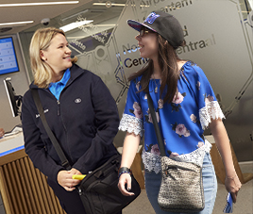
I can book assistance before starting my journey.
If I encounter difficulties when travelling alone,
I can ask for help from the SNCB’s assistance teams.
This is a free service, on reservation,
open every day from 7 a.m. until 9:30 p.m.
and available in 159 train stations.
To book,
simply telephone 02.607.30.00,
- 24 hours in advance if it’s a small station, or
- 3 hours in advance if it’s a larger station.
Find out more
about the assistance service, on the website: sncb.be.

Slide 8
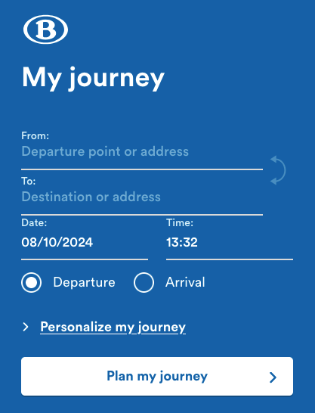
Find information about the itinerary,
timetable and platform number.
On the SNCB website
www.sncb.be

Slide 9

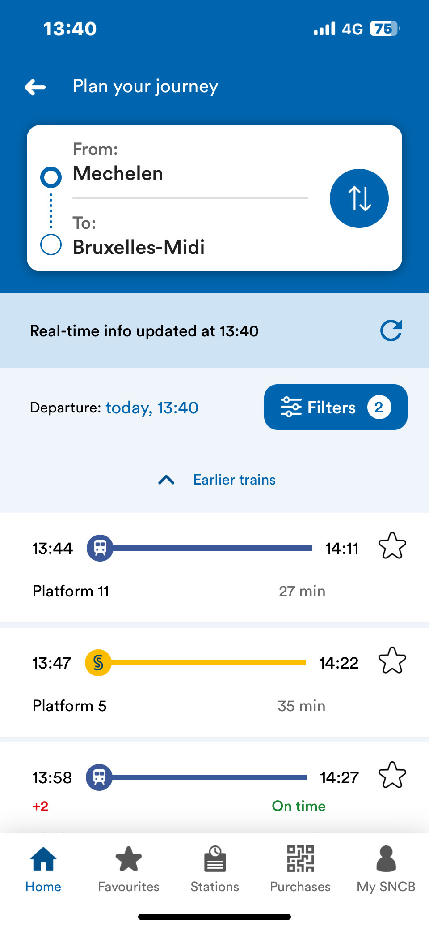
Find information about the itinerary, timetable
and platform number.
On the free SNCB app.

Slide 10
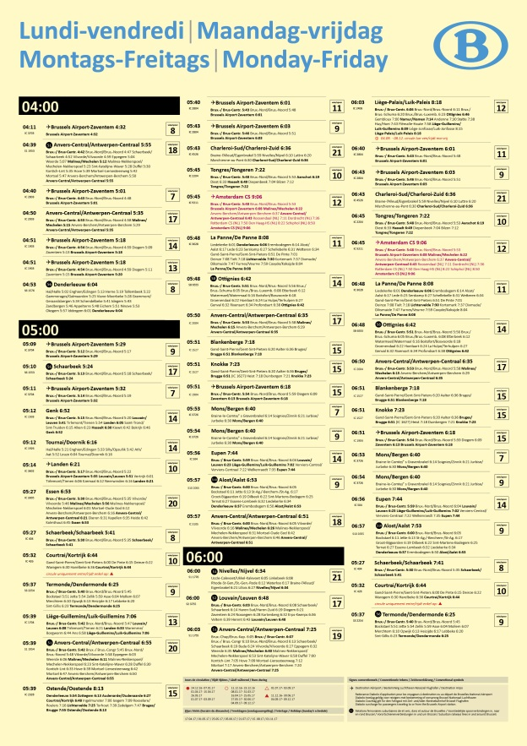
Find information about the itinerary, timetable
and platform number.
At the station, on the yellow posters.

Slide 11
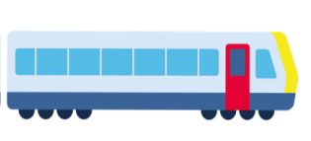



Outbound journey
Write down useful information about your journey.
I’m going to
Write down the destination station
Time
Write down the departure time
Platform
Write down the expected platform number
Direction
Write down the direction of the train

Slide 12
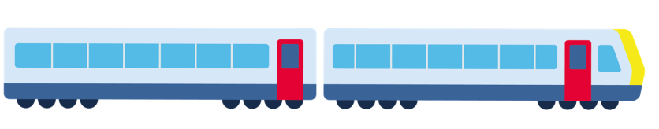
Return
Write down useful information about your journey.
I’m going to
Write down the destination station
Time
Write down the departure time
Platform
Write down the expected platform number
Direction
Write down the direction of the train

Slide 13
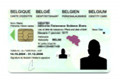
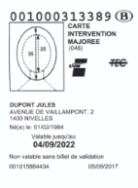
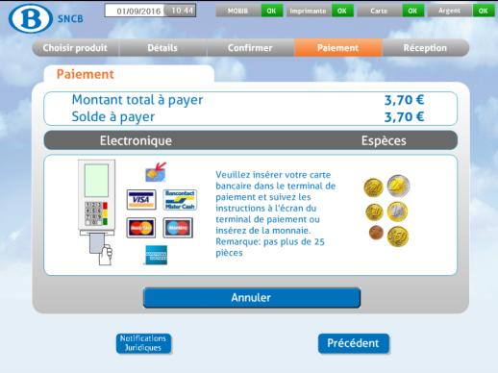
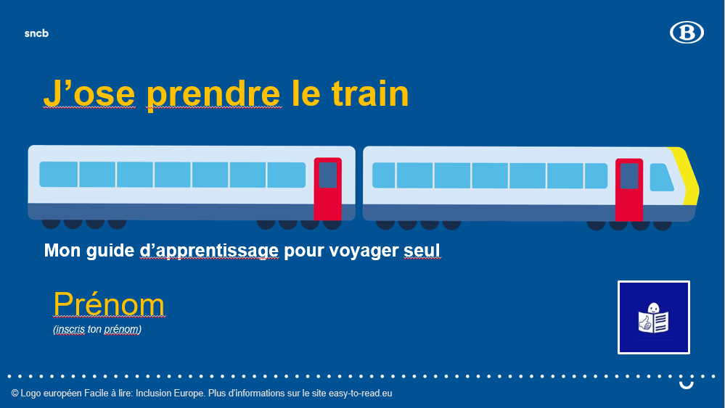
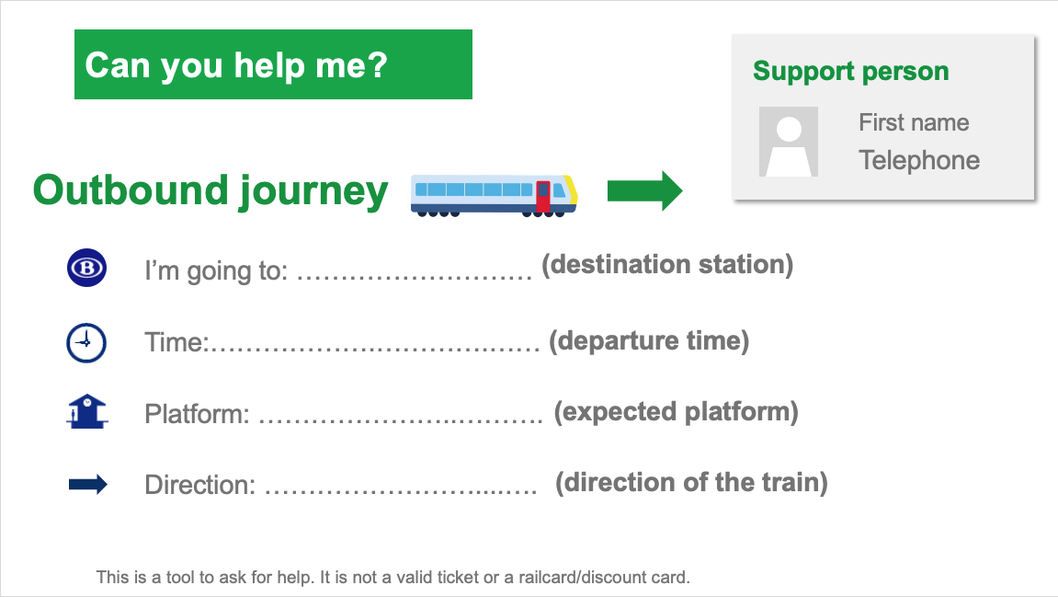
Forgotten anything?
Before leaving, I check I haven’t forgotten anything.
My discount card,
if I have one.
My identity card or passport.
My money
or bank card.
My train ticket
if I bought it in advance.
My guide.
My mobile telephone
with the SNCB assistance number
02 607 30 10 already saved
My assistance card.

Slide 14
I locate the entrance of the departure station

Slide 15

I locate the entrance to the station.
Add a photo of the departure station here
by looking online
by adding a photo you’ve taken yourself.
Write down the name
of your departure station.

Slide 16



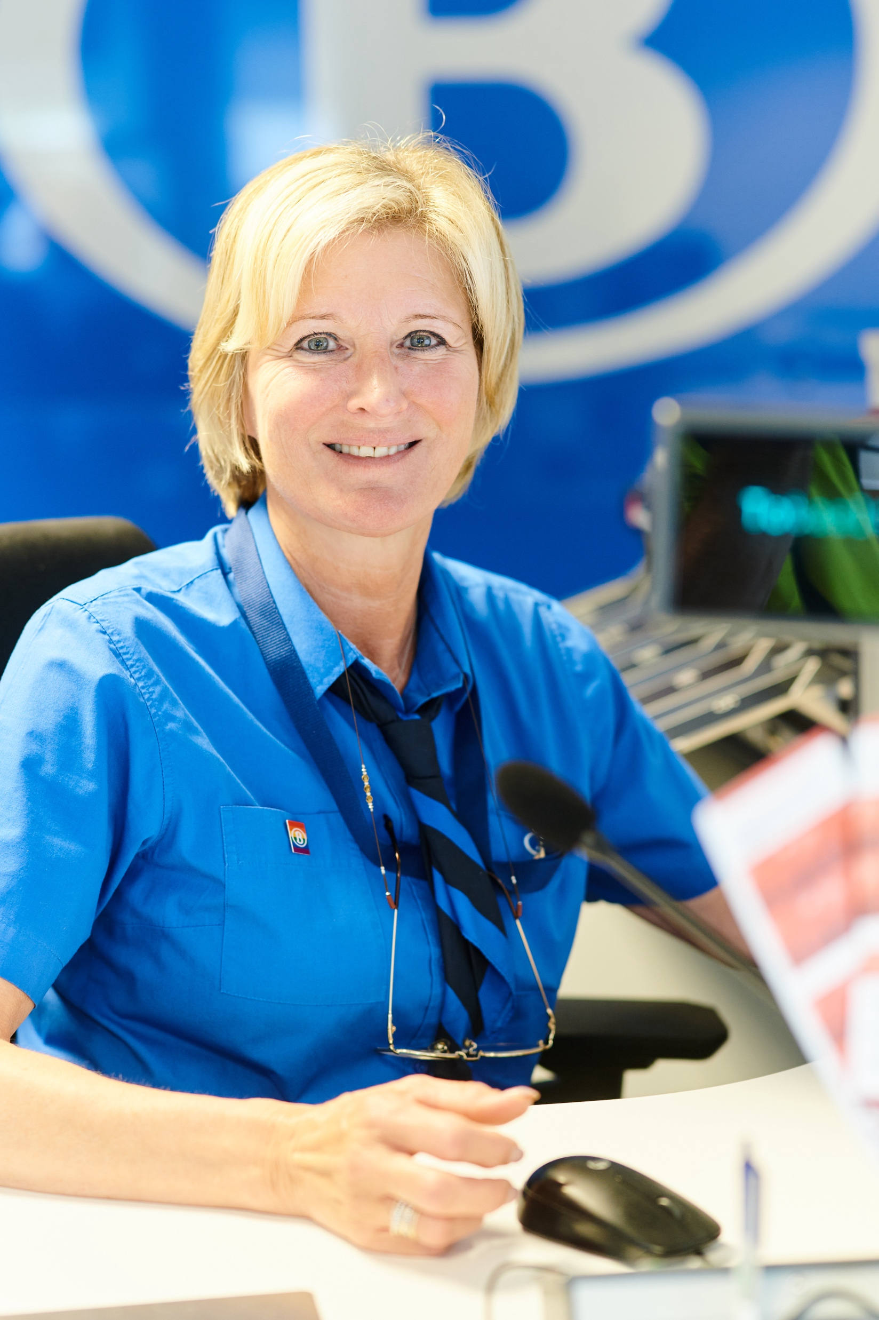
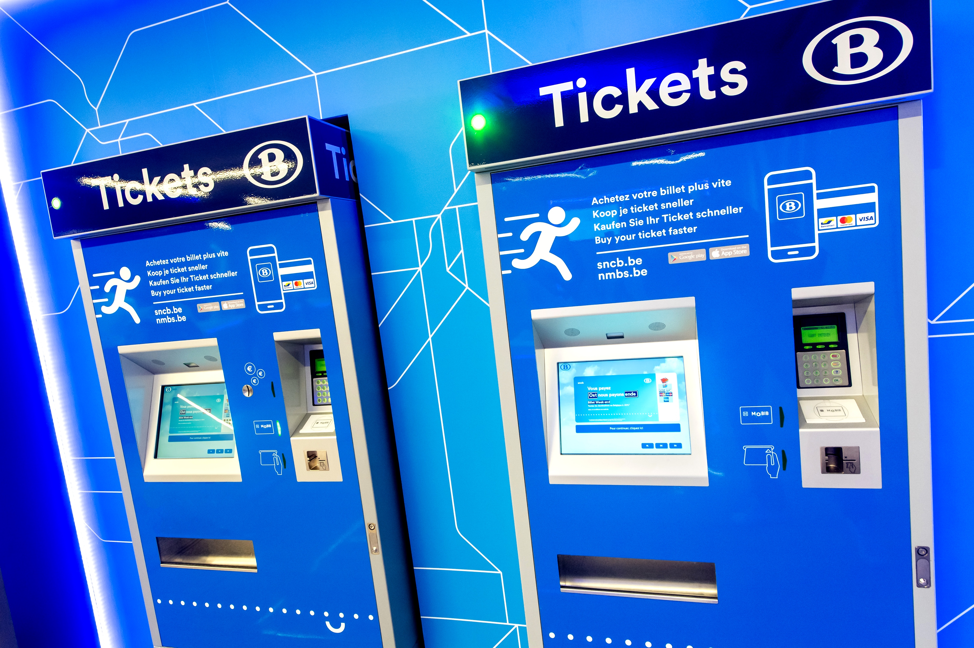
I find my way looking to the pictograms.
I learn to recognise pictograms to find my way around.
Path to follow
Ticket counters
Ticket machines

Slide 17
I buy my train ticket

Slide 18

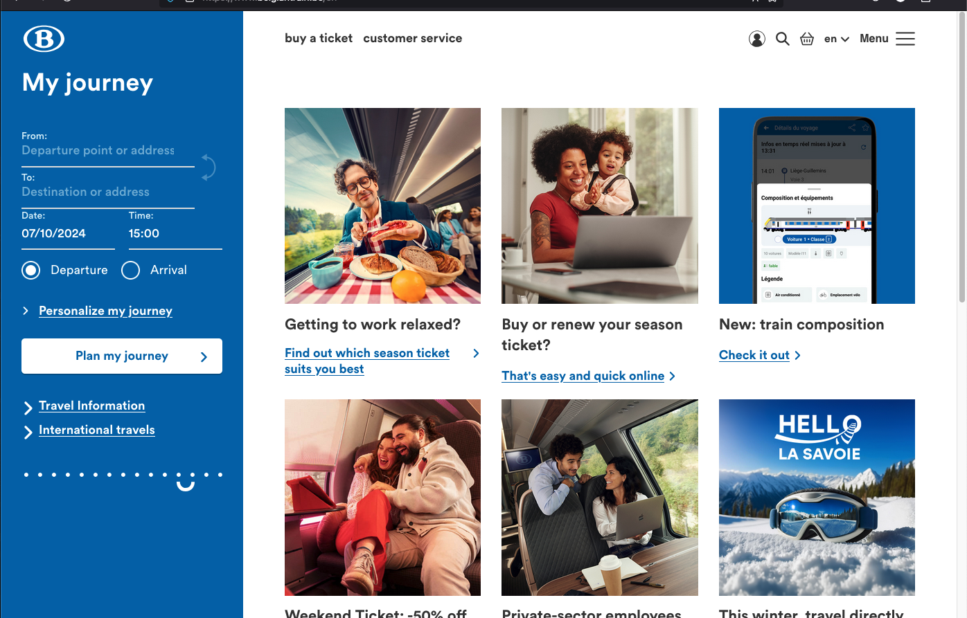
My train ticket on my identity card.
Go to the www.sncb.be website
Buy your train ticket
with your support person.

Slide 19
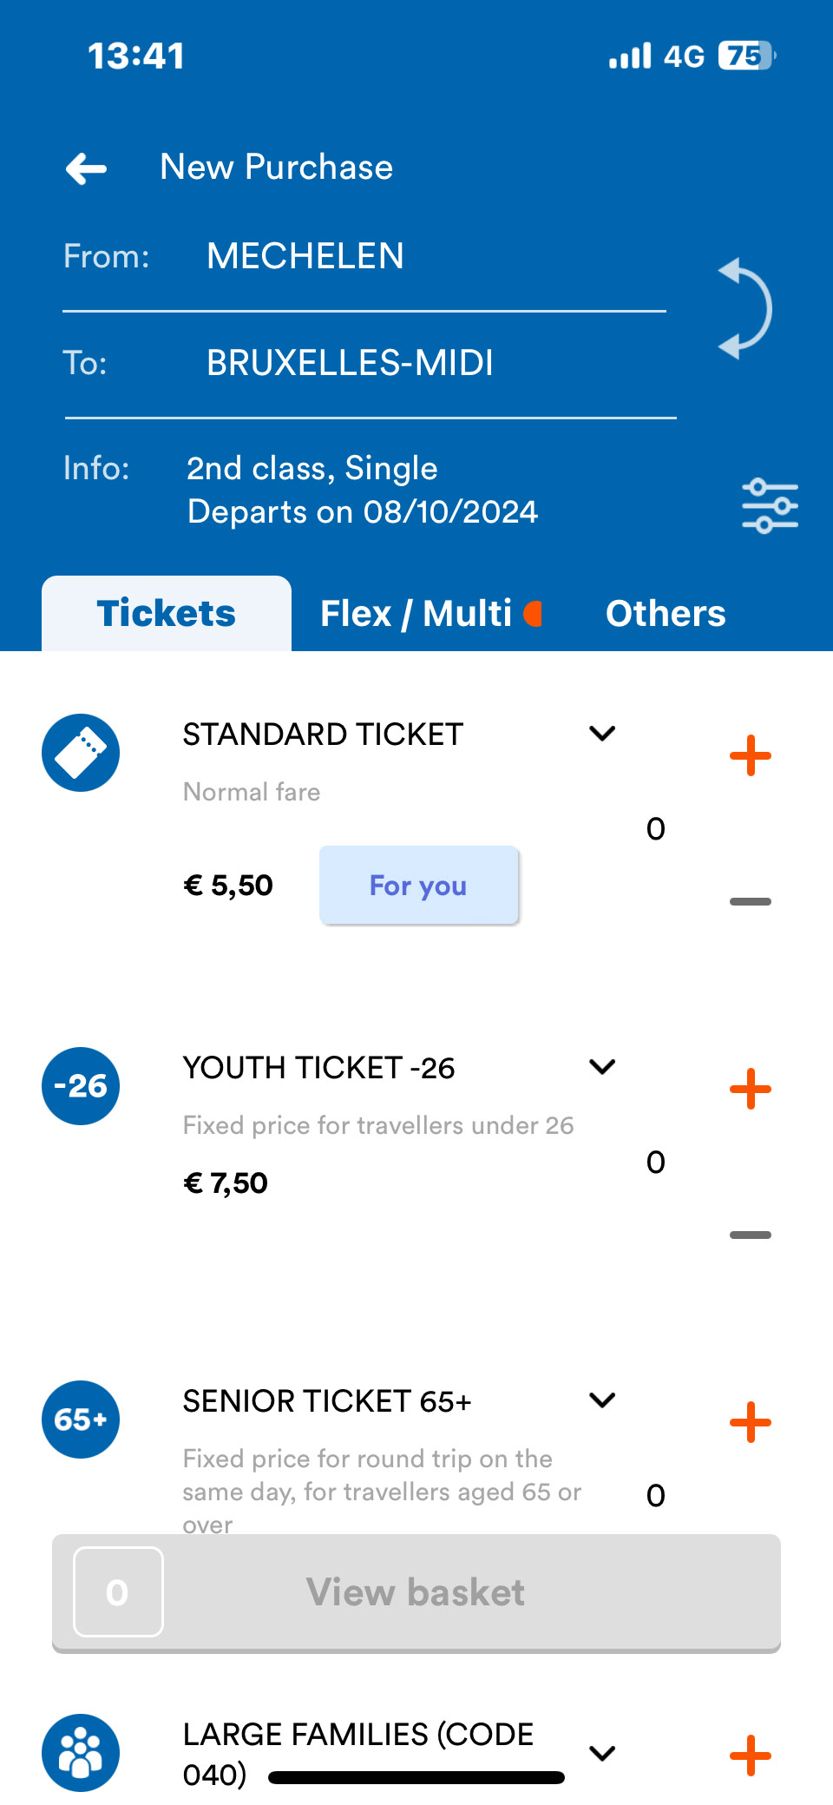
My train ticket on my mobile phone.
I go to the SNCB app.
I buy my train ticket
with your support person.
I save my train ticket to my mobile telephone.

Slide 20
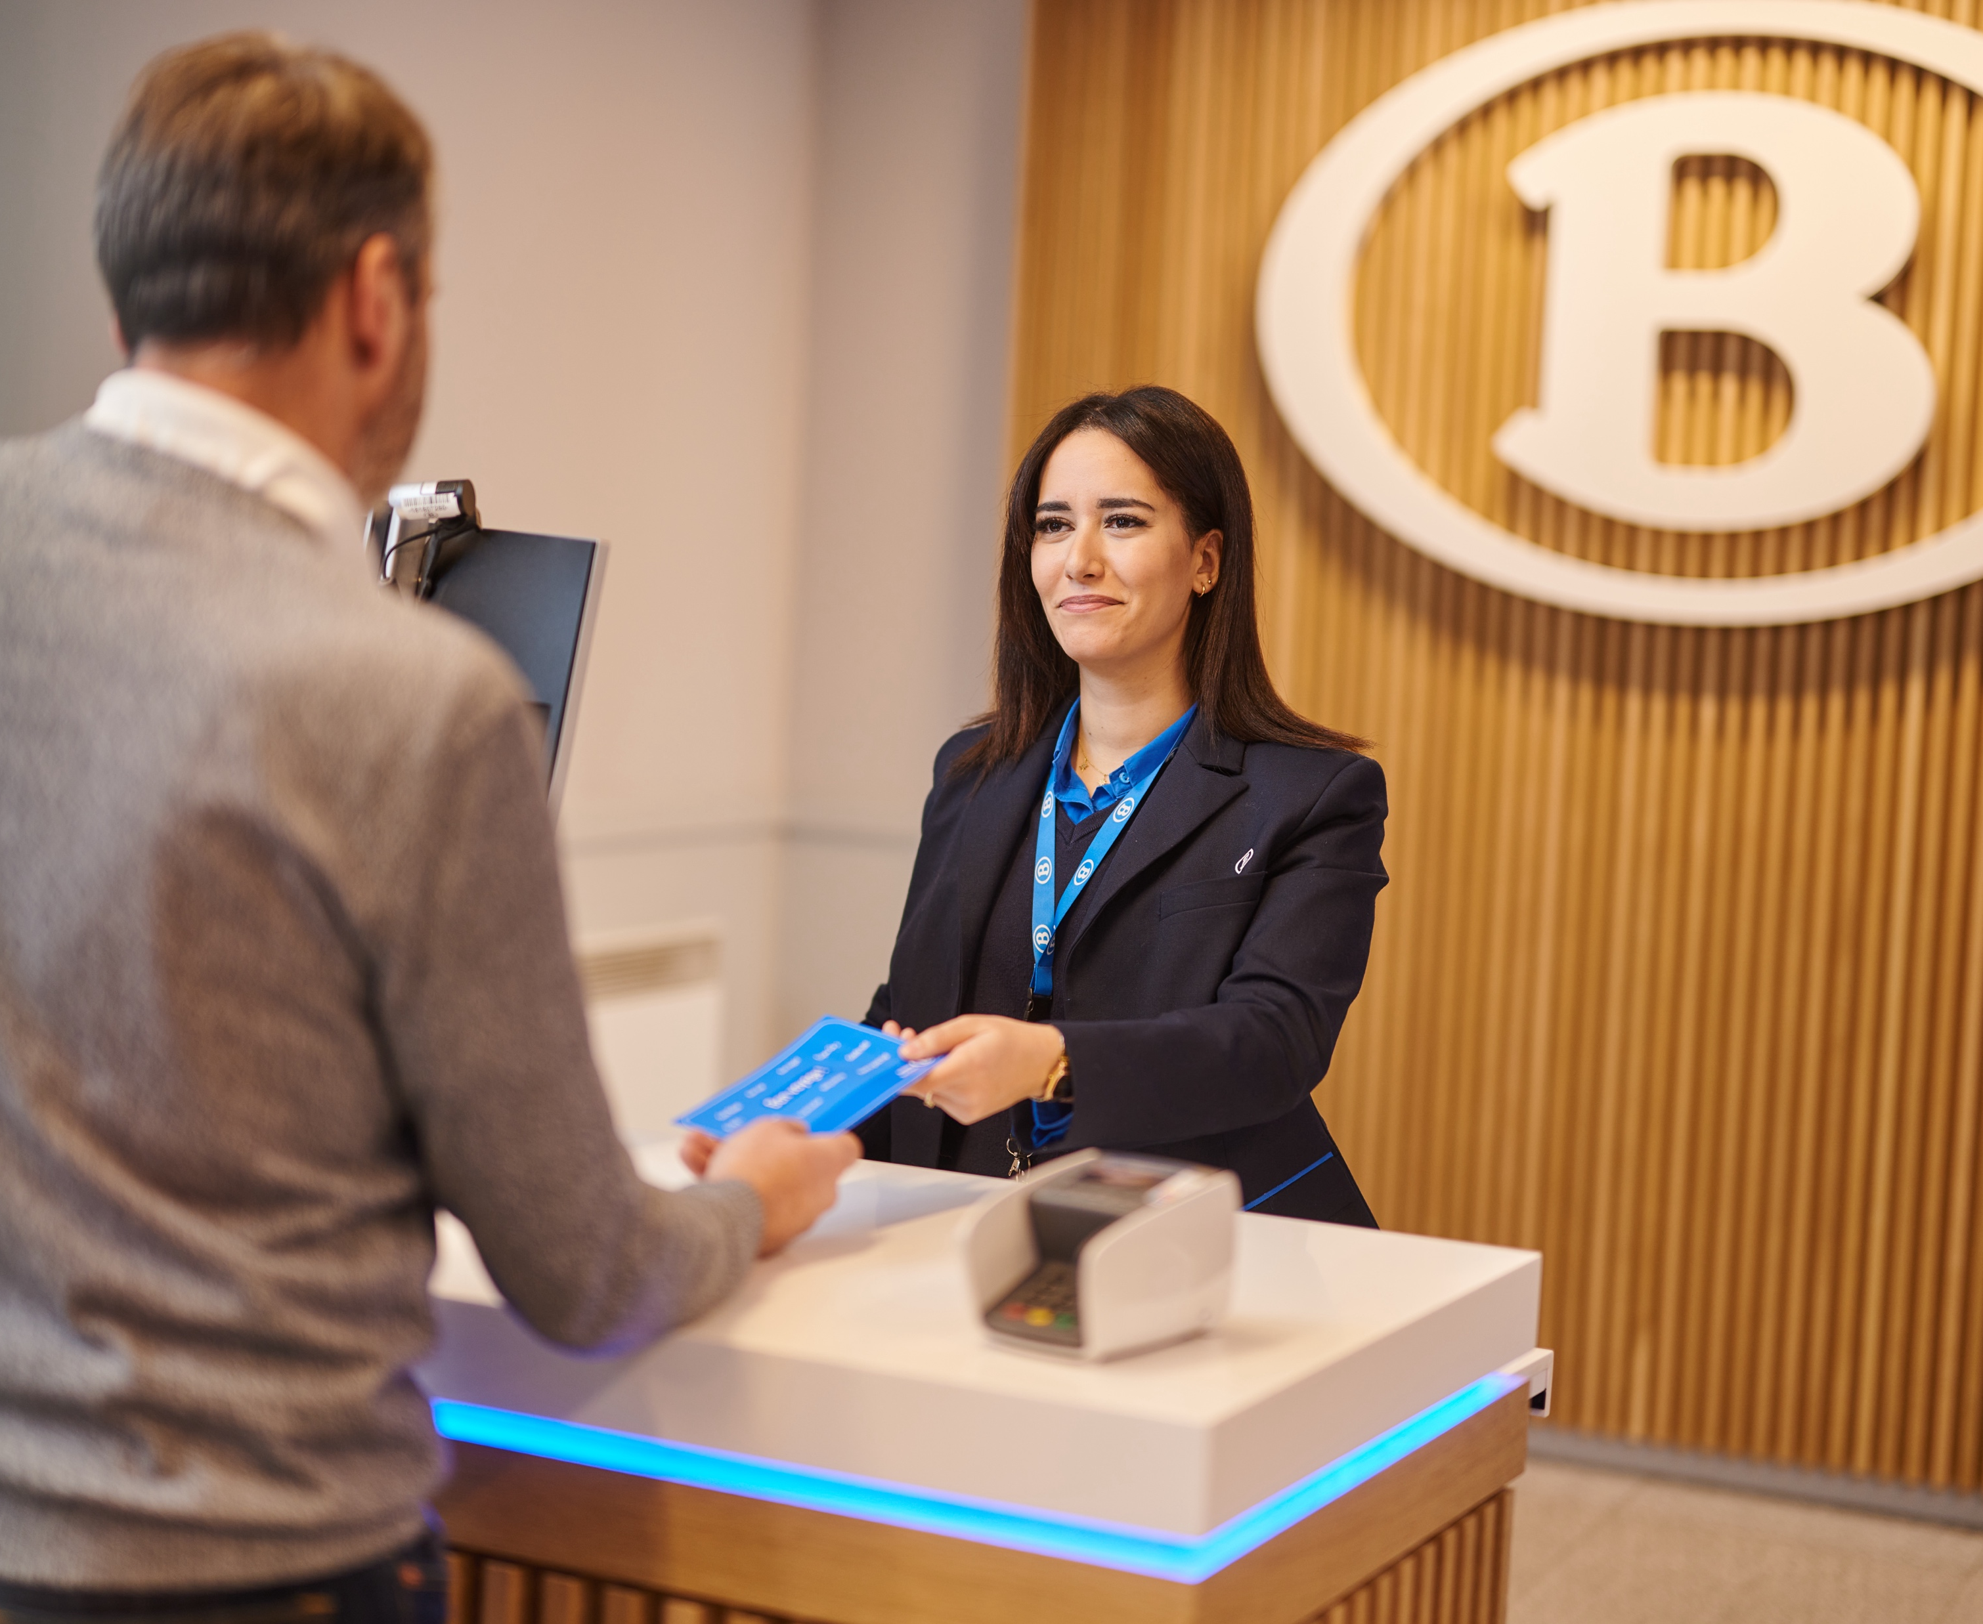
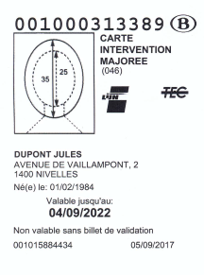
My train ticket at the counter.
I tell where I want to go.
I show my railcard,
if I have one.

Slide 21
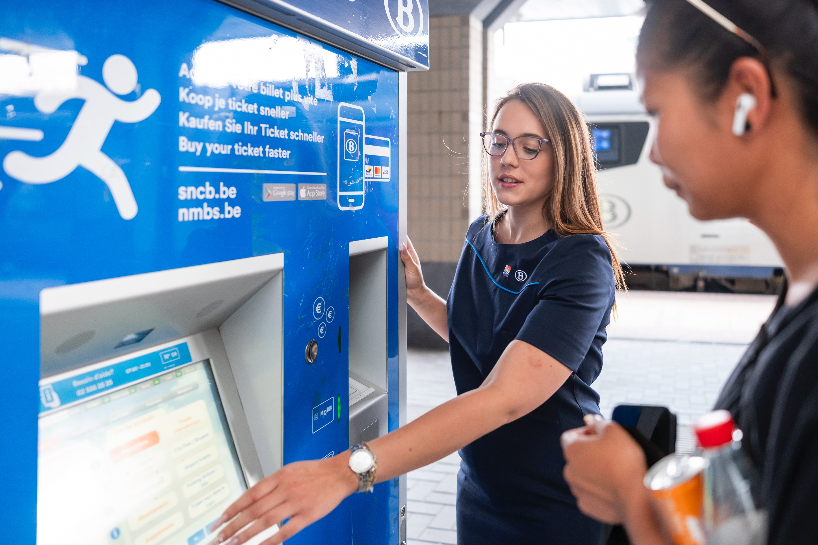
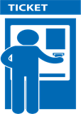
My train ticket at the ticket machine.
I can buy train tickets from the ticket machine, also known as a Ticket Vending Machine (TVM), i.e. a vending machine that produces tickets.

Slide 22
What if I have trouble reading?

Slide 23
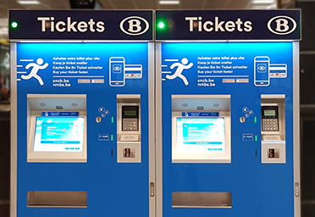
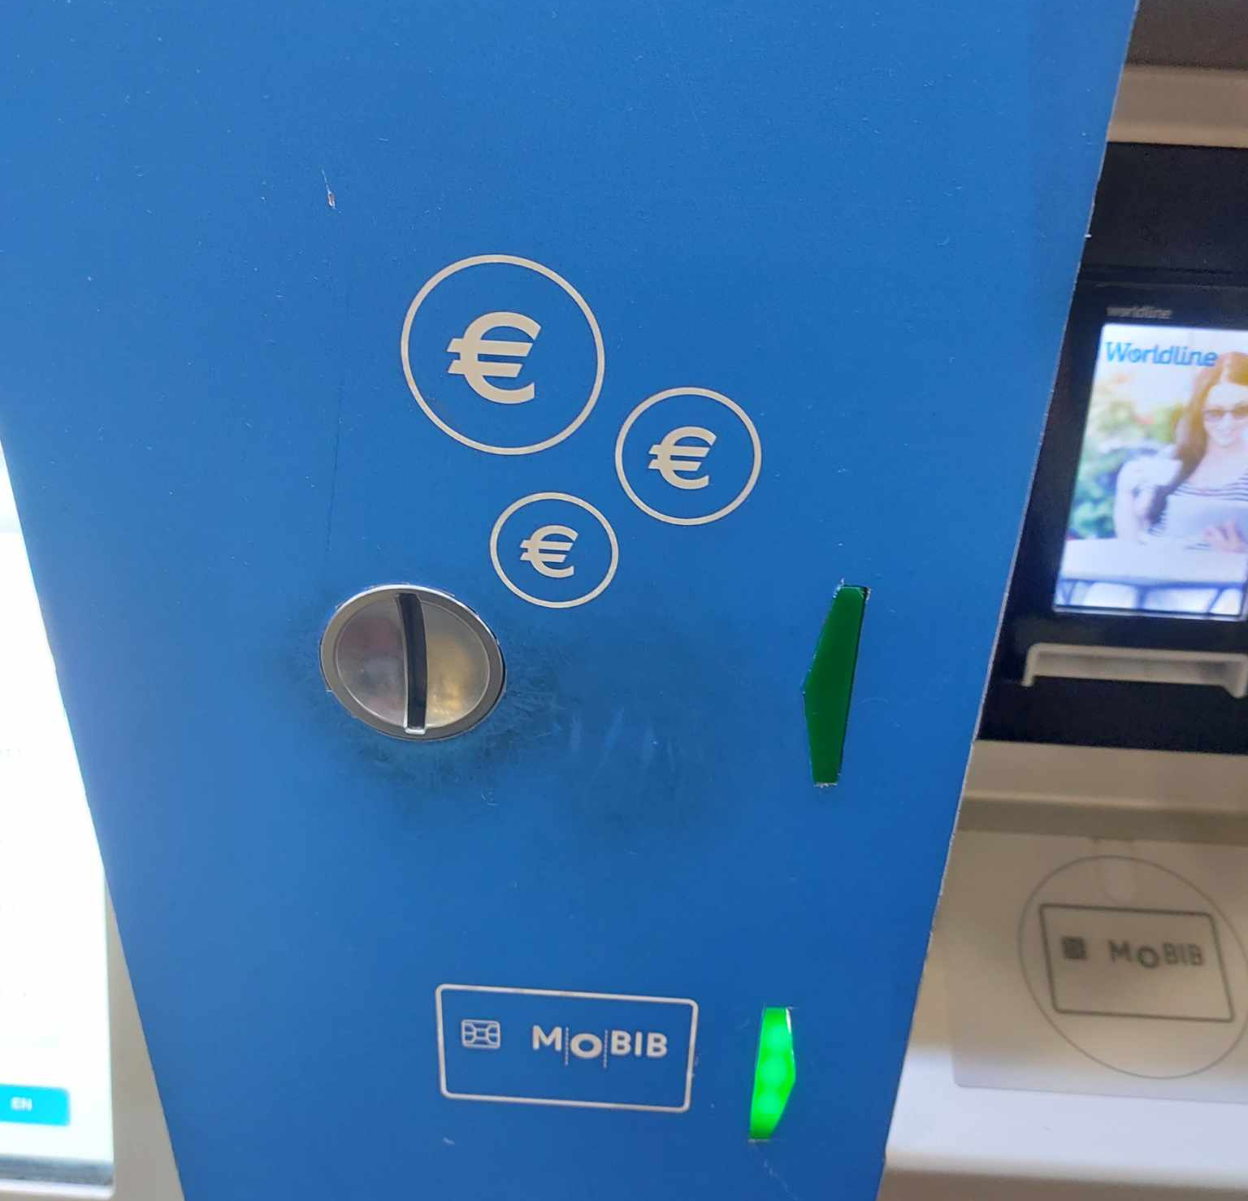
If I don’t have a bank card,
I go to a ticket machine that takes cash.
I can buy train tickets from the ticket machine, also known as a Ticket Vending Machine (TVM), i.e. a vending machine that produces tickets.
This is where I put the coins in.

Slide 24
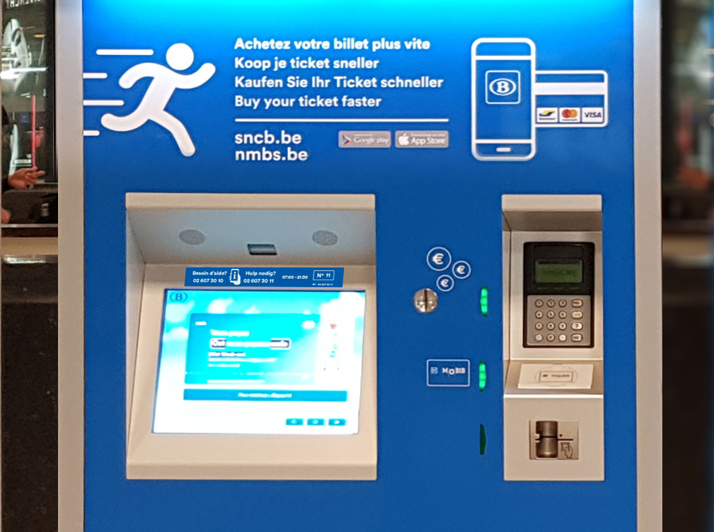

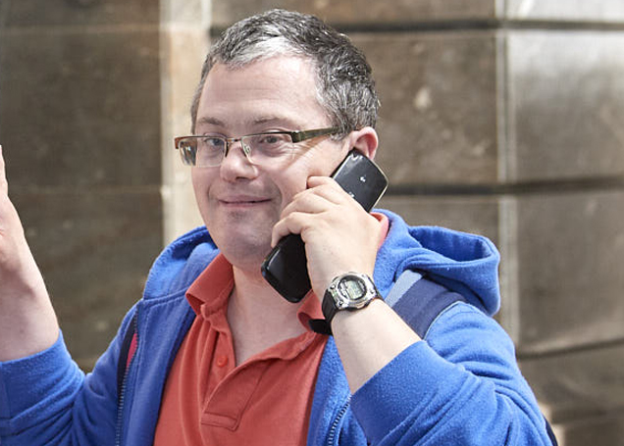
I call SNCB staff if I need help buying my train ticket from the ticket machine.
The SNCB staff can help me over the phone to buy my train ticket.
02 607 30 10

Slide 25

I call SNCB staff if I need help buying my train ticket from the ticket machine.
If I use earphones, I put them.
So I will be able to hear better.
It’s easier to put the money into the machine when I have to pay.

Slide 26



I say on the telephone.
I tell which station I am in.
14
I tell the number of the machine I want to use.

Slide 27
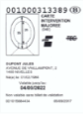
I say on the telephone.
I tell where I want to go.
I tell if I have a railcard or discount card.

Slide 28
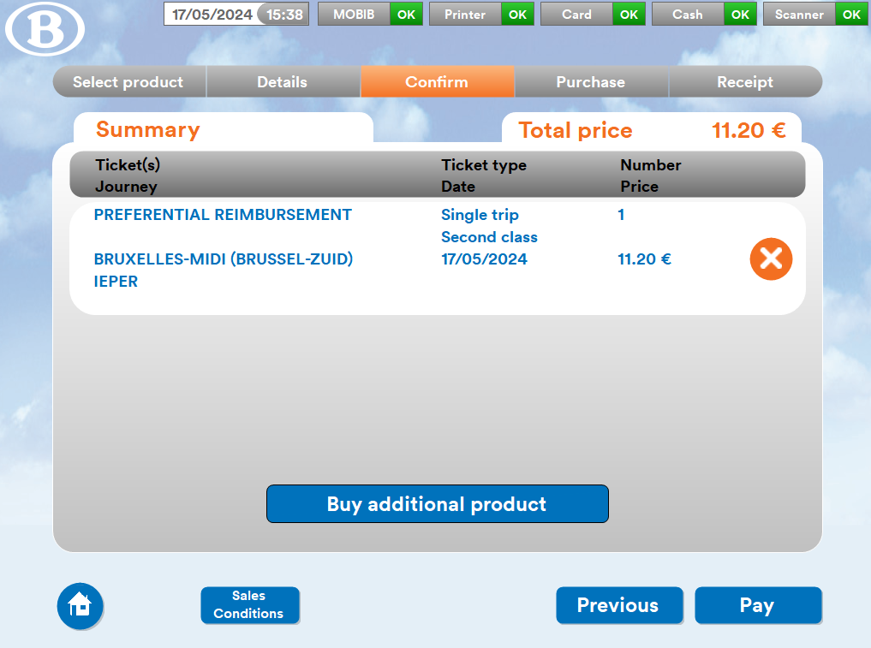

The person on the telephone has selected my train ticket.

Slide 29
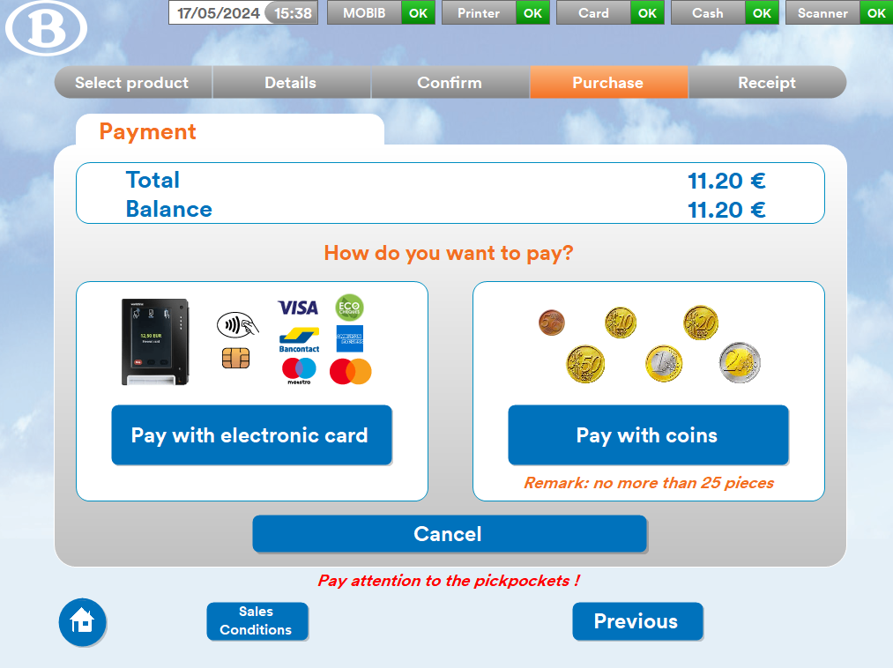

I can see the price of my train ticket on the screen.

Slide 30
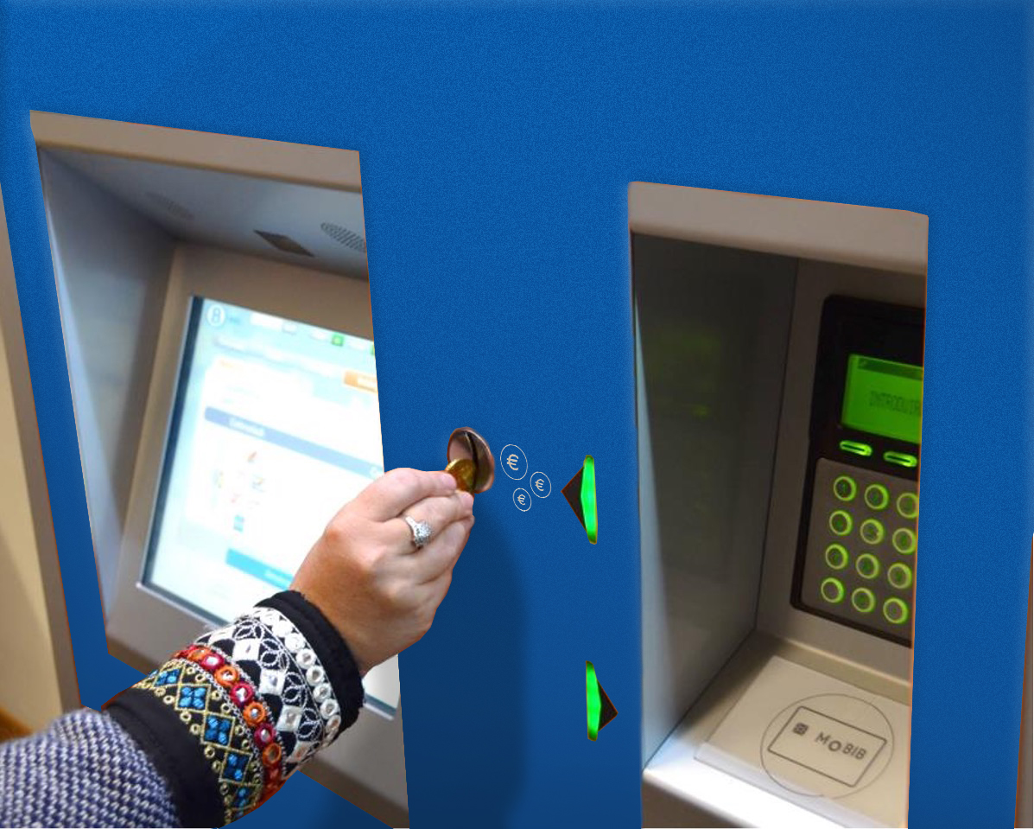
I pay for my train ticket at the ticket machine

Slide 31
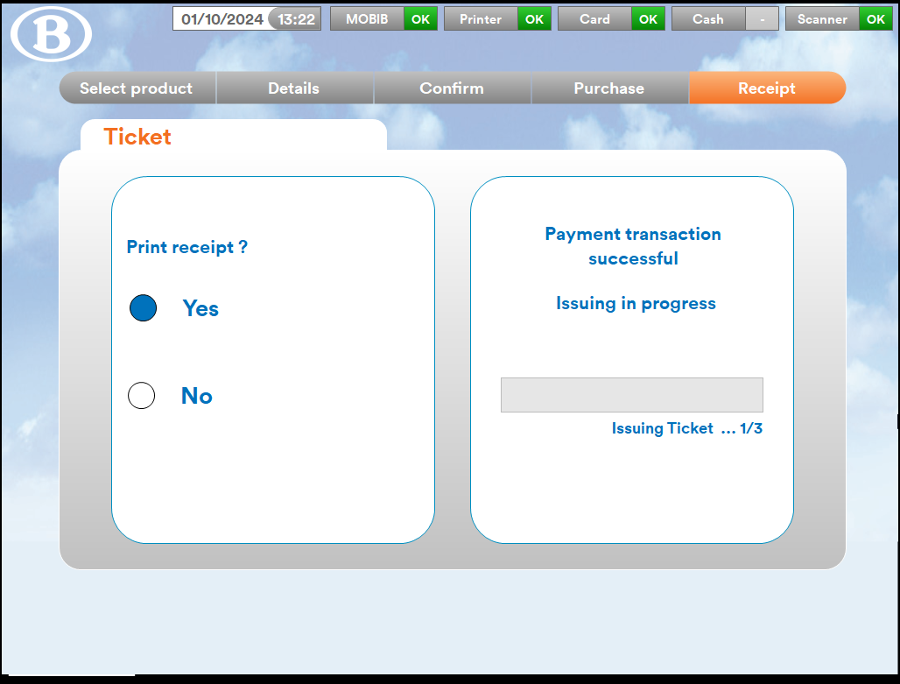
Payment complete!
A receipt will be printed
along with my train ticket.

Slide 32
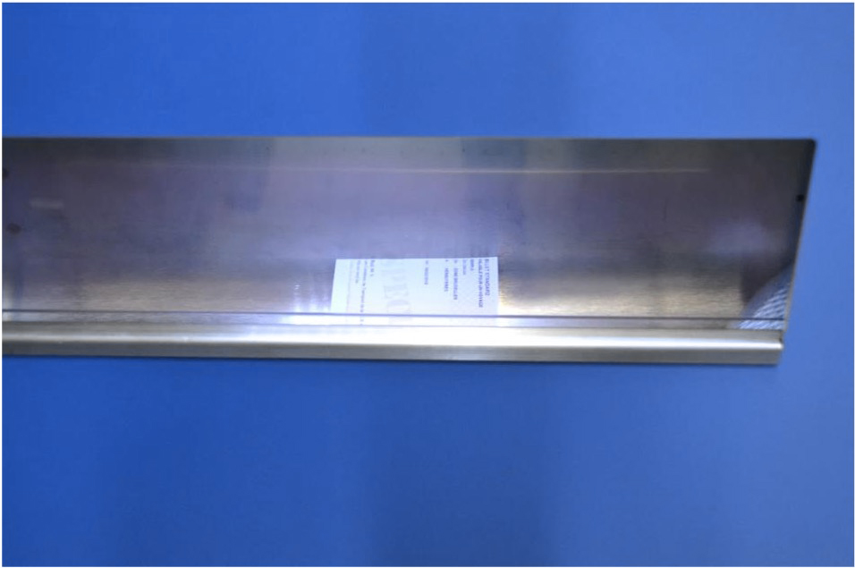
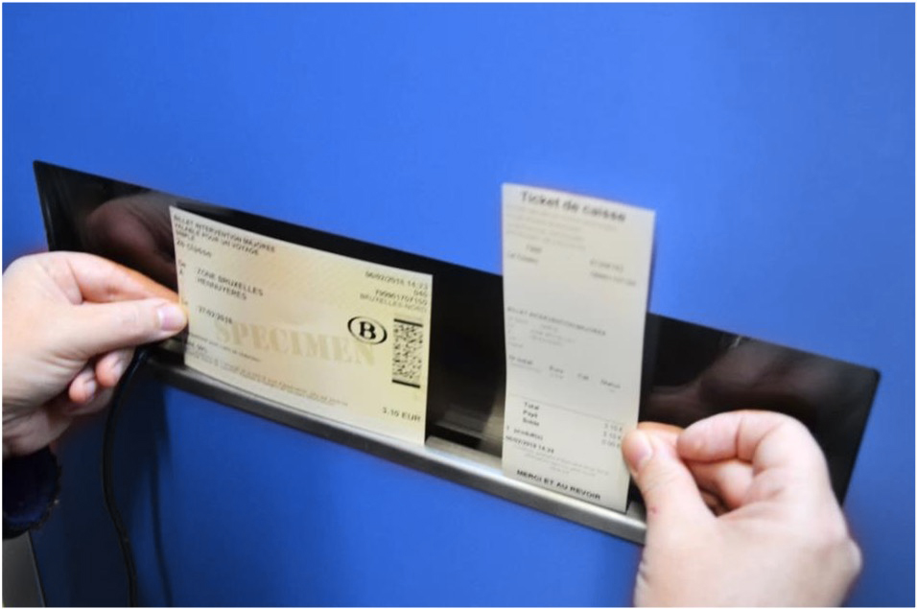
I take my train ticket and my receipt from the machine.
Ticket
Receipt

Slide 33
I can read and write.

Slide 34
If I don’t have a bank card,
I go to a ticket machine that takes cash.
I can buy train tickets from the ticket machine, also known as a Ticket Vending Machine (TVM), i.e. a vending machine that produces tickets.

Slide 35
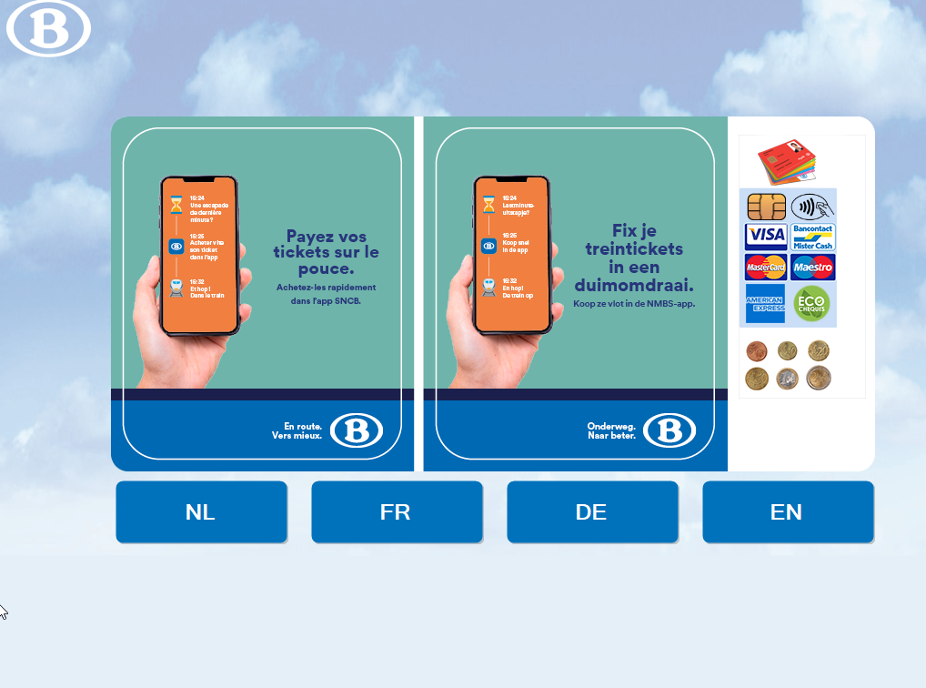
I select English by pressing EN.

Slide 36
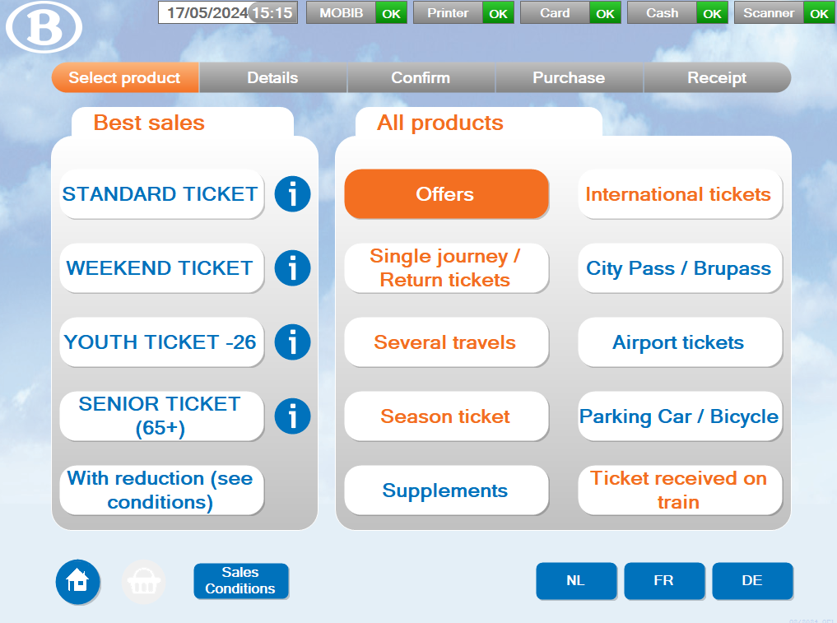
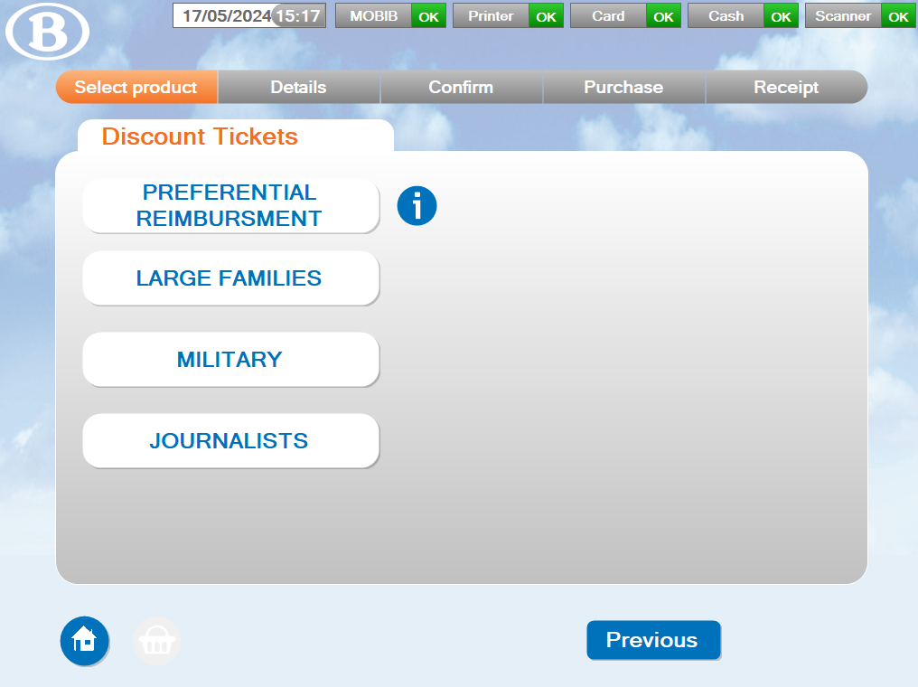
If I have a “Preferential Reimbursement”
(“Intervention Majorée”) discount card, select
“With reduction” then “Preferential Reimbursement Ticket”.

Slide 37
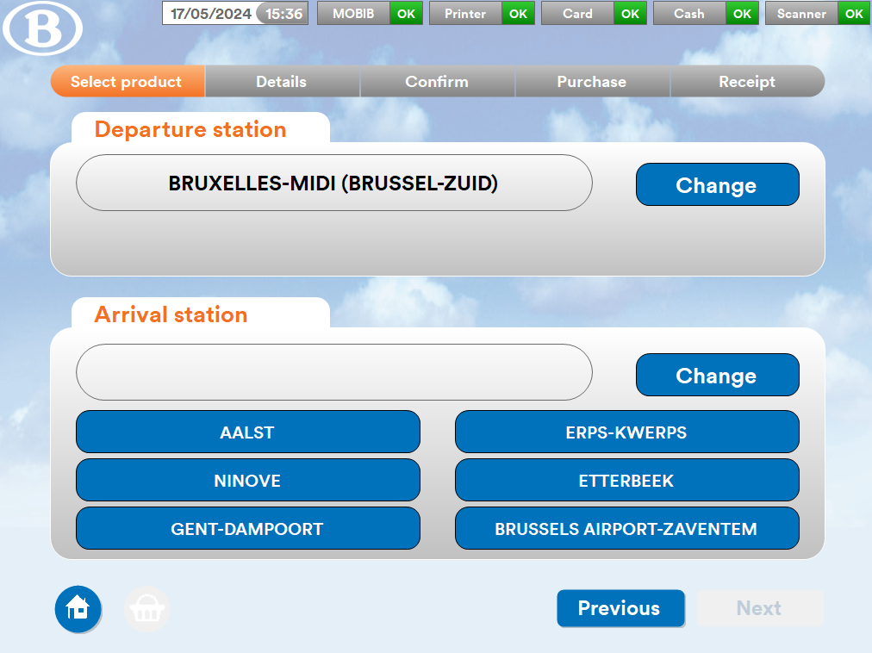
I press on the pre-selected departure station or I change the pre-selected departure station

Slide 38
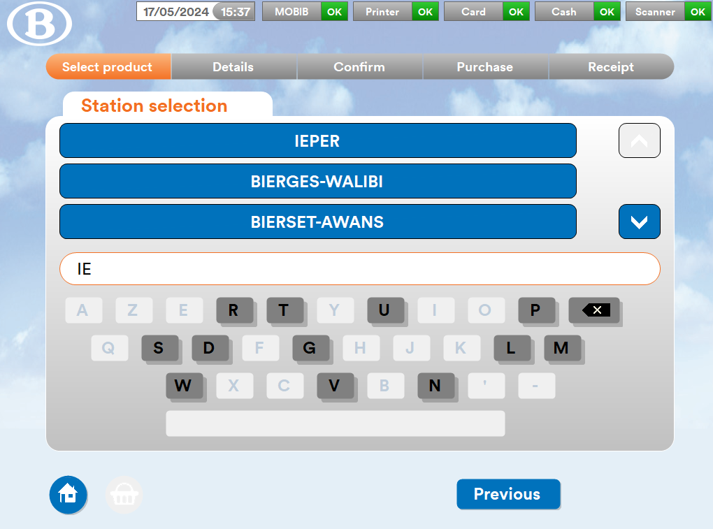
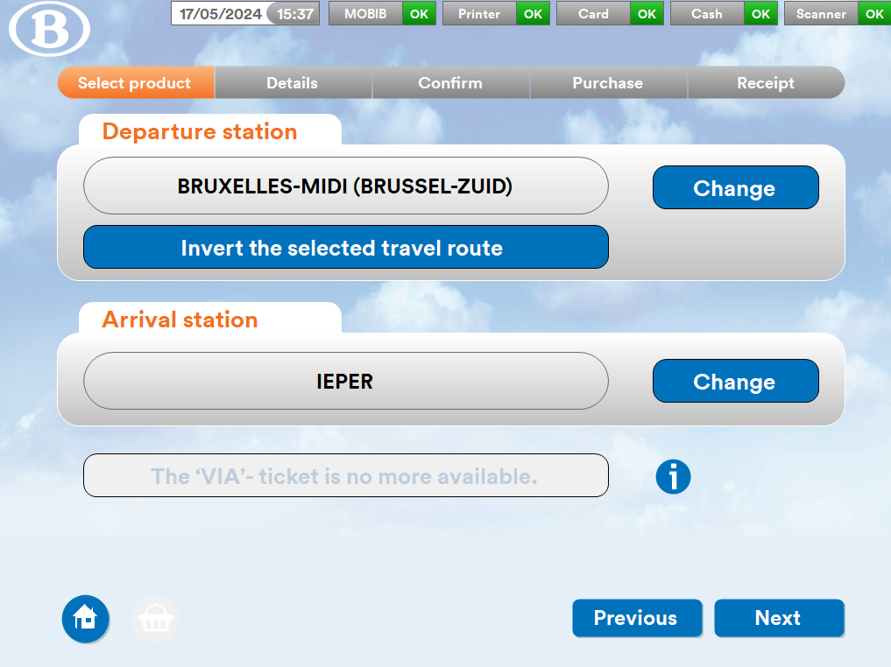

I write the name of my destination station and press next.

Slide 39
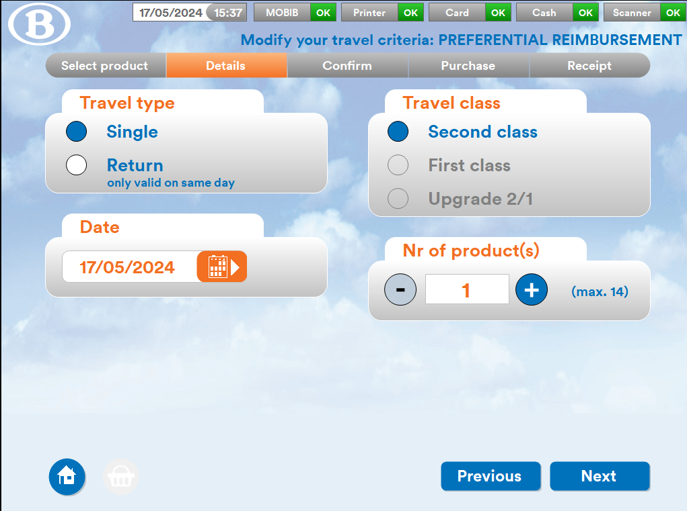
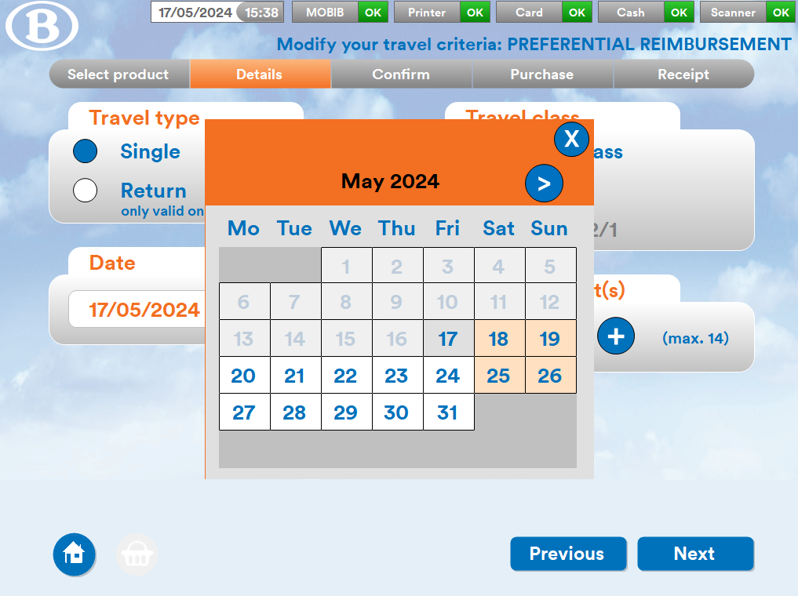

I select
a single or return journey;
the date;
the number of travellers;
the class of ticket.

Slide 40
I press “Next” then press “Pay”.

Slide 41
I see the price of my train ticket on the screen.

Slide 42
I pay for my train ticket at the ticket machine.

Slide 43
Payment complete!
A receipt will be printed
along with your train ticket.

Slide 44
I take my train ticket and my receipt from the machine.
Ticket
Receipt

Slide 45
I go to the platform

Slide 46
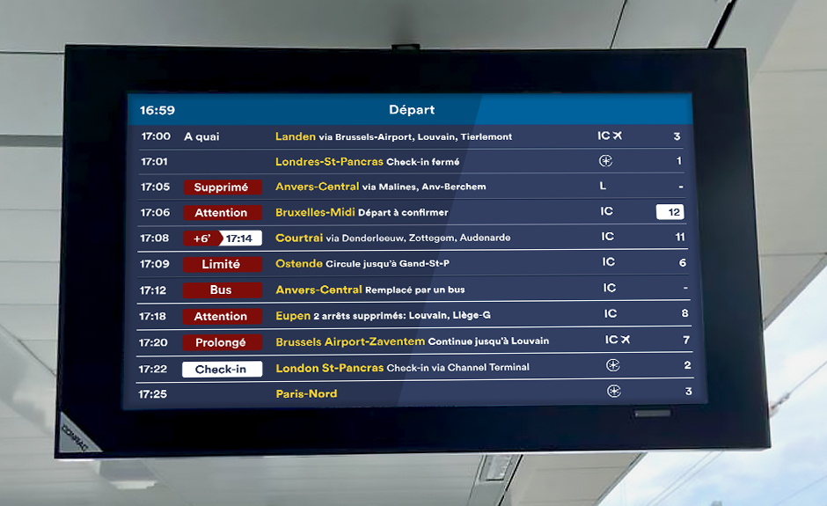
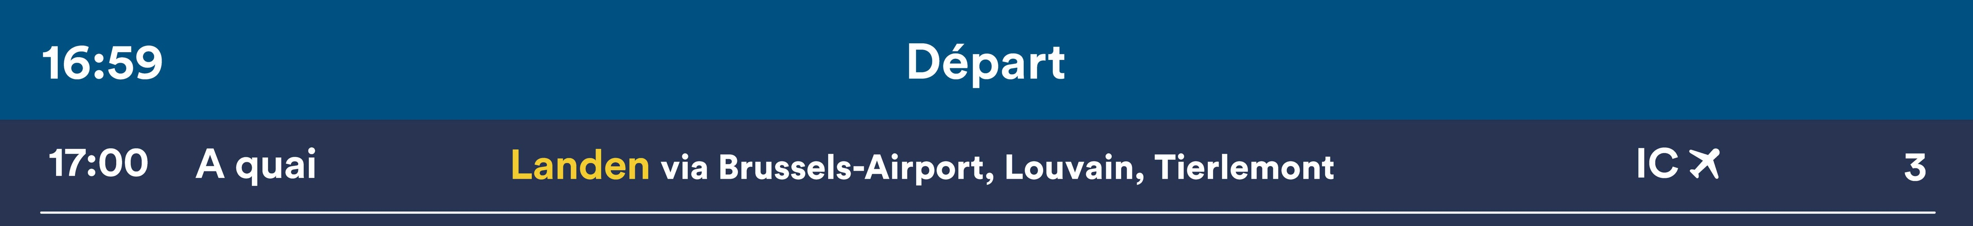
I look at the train display panel.
For example:
Direction of the train
Platform number

Slide 47
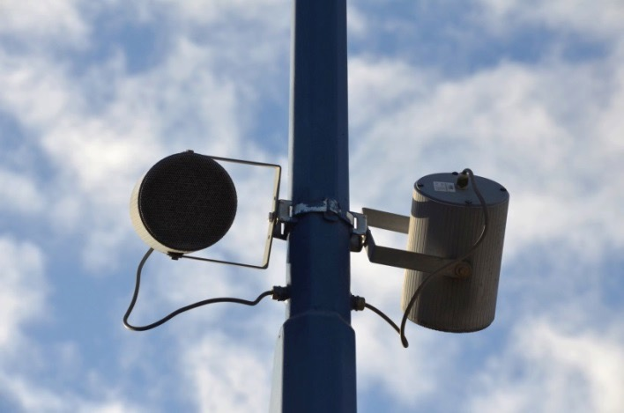

I listen to the speaker announcements.
The train to Brussels-Midi
is arriving on track 21.

Slide 48
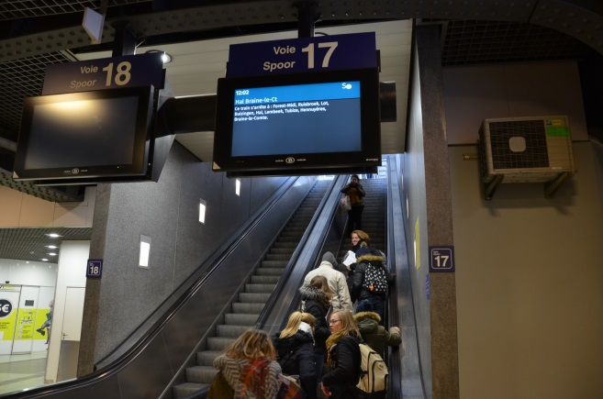
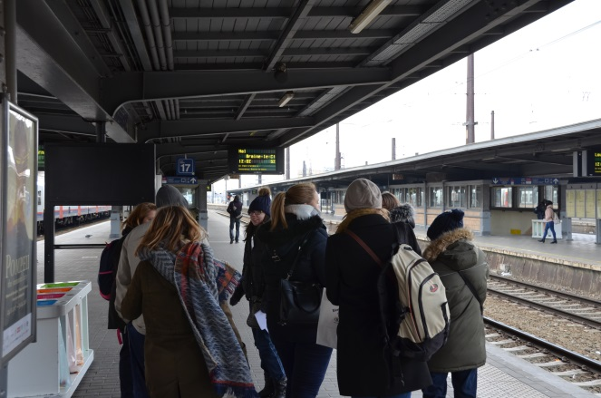
I go to the platform.
I go to the platform before the train arrives.

Slide 49
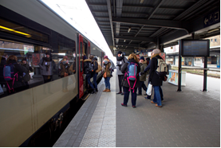
The train is on platform.
I can board the train.

Slide 50
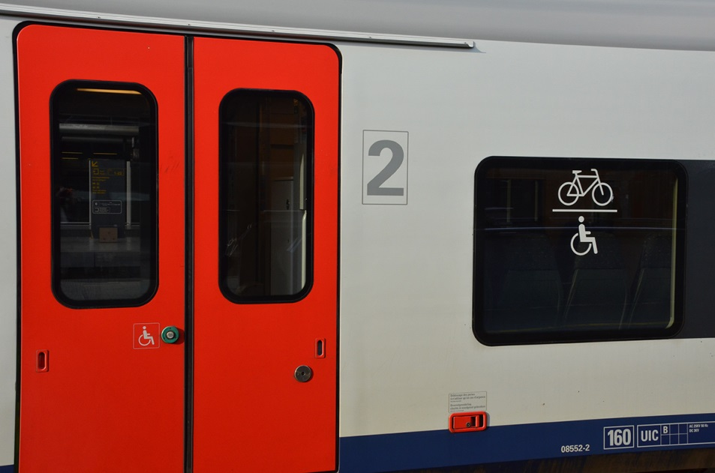
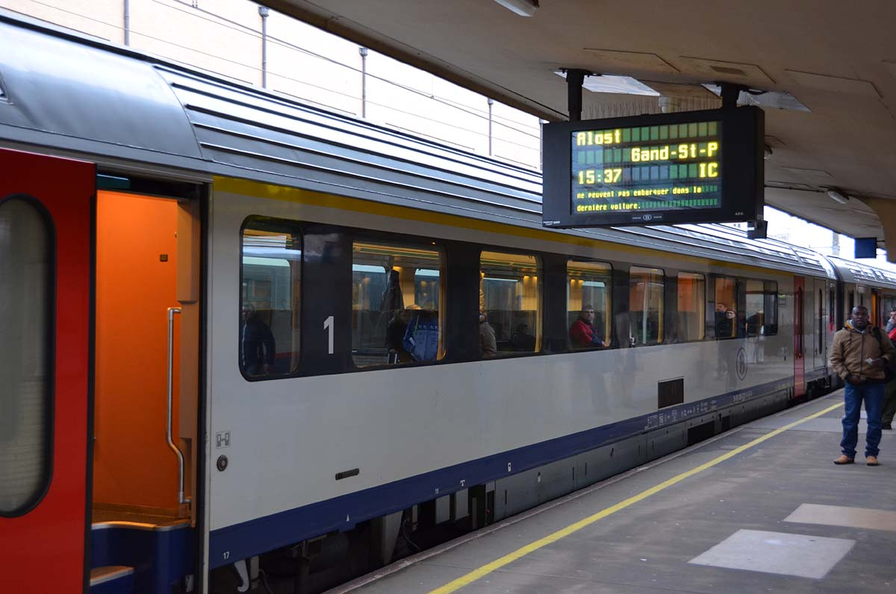
When the train has stopped,
I press the button to open the doors and board the train.

Slide 51
Timetable changes are displayed in red.
My train is arriving 6 minutes late.
17:08
17:14

Slide 52
Train changes are displayed in red.
My train has been cancelled.
I listen to the announcement that tells me which train to take instead.

Slide 53
Platform changes are displayed against a white background.
The platform at which my train is arriving has changed.
I listen to the announcement that gives me the new platform number.
Platform change.

Slide 54
I board the train

Slide 55
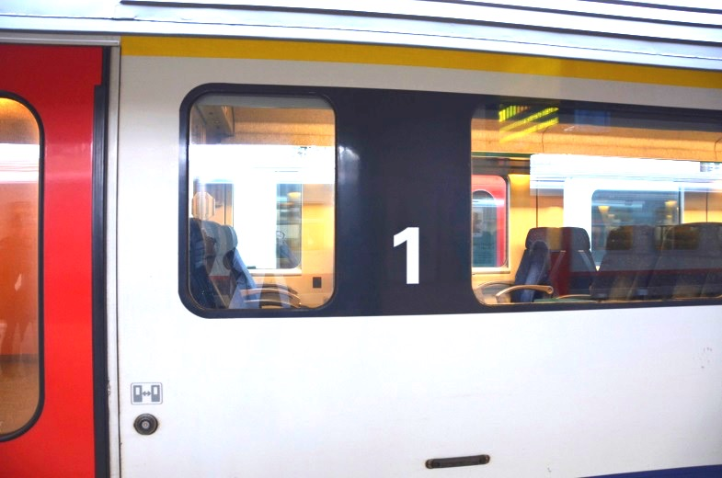
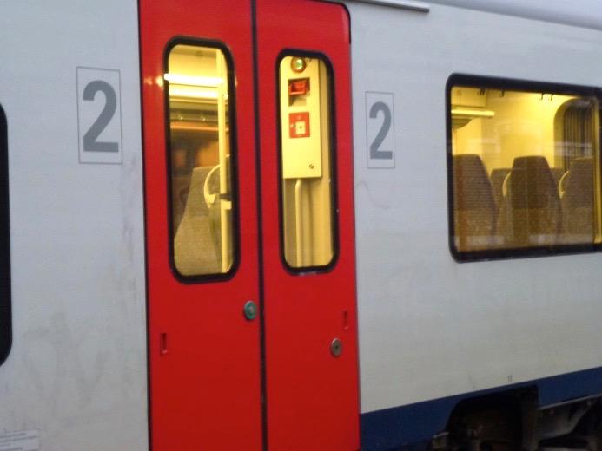
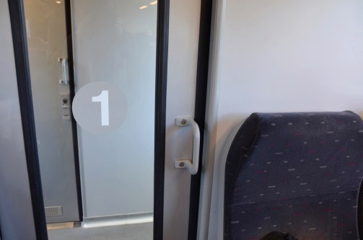

I board the train
I look at the coach numbers written on the train.
I board in 2nd class if you have a 2nd class ticket.
I board in 1st class if you have a 1st class ticket.
first class
second class

Slide 56
I sit in the train and pay attention to the stops

Slide 57



I pay attention to the stops and listen to the announcements in the train.
I watch
the display screen.
I track my journey
on my mobile phone app
or on my guide.
I look at the stops
in my guide.
All this is explained
on the next page.

Slide 58
How can I follow the stops on my journey if I have difficulty reading?
When learning to travel,
there is an easy way
to follow the stops and
know where I need to get off.
On the following page, I can add the same number of
circles as the number of stops.
Each circle is one stop.
I can use these circles to see how many stops I have travelled.
If I can read a little,
I can also write down the names of the stops.
If I need to change trains in a connecting station,
I can do the same thing for the next part of my journey.

Slide 59

Stops for my OUTBOUND journey
1 2 3 4 5
destination station:
departure station:
The number of grey circles is the same as the number of stops.

Slide 60
Stops for my RETURN journey
1 2 3 4 5
departure station:
destination station:
The number of grey circles is the same as the number of stops.

Slide 61
My journey’s stops if I have to change trains
departure station:
1 2 3
connecting station at which you change:
Time:
Platform:
Direction:
1 2 3
destination station:

Slide 62

I arrive at my destination and get off the train

Slide 63
I am arrived at my destination.
Write down the name
of your destination station.
Add a photo of the station of arrival here
by looking in internet
or by adding a photo you’ve taken yourself.

Slide 64


Once the train has stopped,
I press the button to open the doors and get off the train.

Slide 65

I exit the station

Slide 66


I exit the station by following the arrows.
Exit

Slide 67
I am arrived!
☺

Slide 68
The assistance card

Slide 69
If I find it difficult to ask for help,
I can use my assistance card.
This card is recognised by the SNCB staff.
I can print it in any format I like.
It makes it easier to ask for help.
If I show this card, someone will come and help you.

Slide 70

Outbound journey
Can you help me?
Support person
First name
Telephone
I’m going to: ………………………
(destination station)
Time:……………….………….……
(departure time)
Platform: …………………..……….
(expected platform)
Direction: ……………………....….
(direction of the train)
This is a tool to ask for help. It is not a valid ticket or a railcard/discount card.

Slide 71
Return journey
Can you help me?
Support person
First name
Telephone
I’m going to:………………………..
(destination station)
Time: ……………………...............
(departure time)
Platform: ………………..……….…
(expected platform number)
Direction:……………………….…..
(direction of the train)
This is an assistance card to ask for help. It is not a valid ticket or a railcard/discount card.

Slide 72
In case of any unexpected issues, problems or safety concerns
SNCB staff are here to help

Slide 73

At the station
The station staff can provide information and guide me.

Slide 74


On the platform
If there’s something I did not fully understand,
I can ask the train attendant.
I use my assistance card.

Slide 75

Onboard the train
The train attendant can help me
if I don’t know which stop
I need to get off at.
If I get on the wrong train,
they can tell me what to do.
They can give me a form
that I should keep on
so I can take the right train.

Slide 76


Wherever I go, for my safety
Securail teams and the police
are here for my safety.
If I feel unsafe,
they will help me.

Slide 77



By telephone
When there is nobody at the station
to help me.
I call the SNCB assistance service.
They will help me over the phone.
If I get lost,
and don’t know what to do.
02 607 30 10
If I am having difficulties
buying a ticket
from the machine.

Slide 78
Have a safe journey

